Slide 1
Shotgun and be safe in the US
Sarah Bismuth & Yalin Yan

Slide 2
Situation
-Gun ownership in the United States is rooted in the Second Amendment of the Constitution: “A well-regulated Militia, being necessary to the security of a free State, the right of the people to keep and bear Arms, shall not be infringed.”
Recent years have seen some of the worst mass shootings in U.S. history.
The regularity of such events has rekindled the gun control debate and invoked comparisons of U.S. gun policies and those of other wealthy democracies.

Slide 3
Motivation to do this Project.
As International student we wanted to have a better understanding of the situation, and find answer to question such as Who are this shooters? Who is concerned by this issue? As a student who studing in New York City, how are you affected by this phenomenon and what precautions can you take to be safer?

Slide 4
Targeted audience and to who the results could be useful?
Everyone who want to have a better understanding of the gunshot situation in the US.
The results could be useful to the government for instance or organizations that are trying to regulate this issue by giving them some insight of who they should have a look at and who need to be more protected.
The result will also be useful for students who wants to be aware of the situation when studying in New York.

Slide 5
Data that we used for this project:
One CSV fill about mass shooting in the US (from Kaggle)
One API dataset introducing the shooting cases happened in New York.

Slide 6

Some of the python features we used to answer the questions (as requirments of final project checklist)
data analytics workflow
grouping( For instance we groups state and number of victims fatalities)
Bar chart/line chart/histogram
EDA
Wordcloud
Basic pandas manipulation
transfer dataframe from wide to long
Statistical analysis
new skills used that not learned in class:1. creat slice in jupter notebook; 2. A new knid of chart to show the analaysis result.

Slide 7
Conclusion:
Shooter average age | 31.6
Shooter sex majority | Male
Shooter military experience | YES for a majority
Mental illness | Almost as many yes as no
Shooter most used gun | Handgun
Shooter race | White american or European American

Slide 8
Issues that we encountered
Issue | Solution
Web scrapping: technical issues, not so many relevant data to scrapped | Find an API
Issue with the shooter age column: unknown values, mix of integer and string Issue with how to draw bar chart or line chart with two cloumns data in a dataframe | Convert unknown to Nan, then create a code that will use only the valid data when we analyze it. By searching the solution online to get the result, and get many useful conclusions by the chart we get.

Slide 9
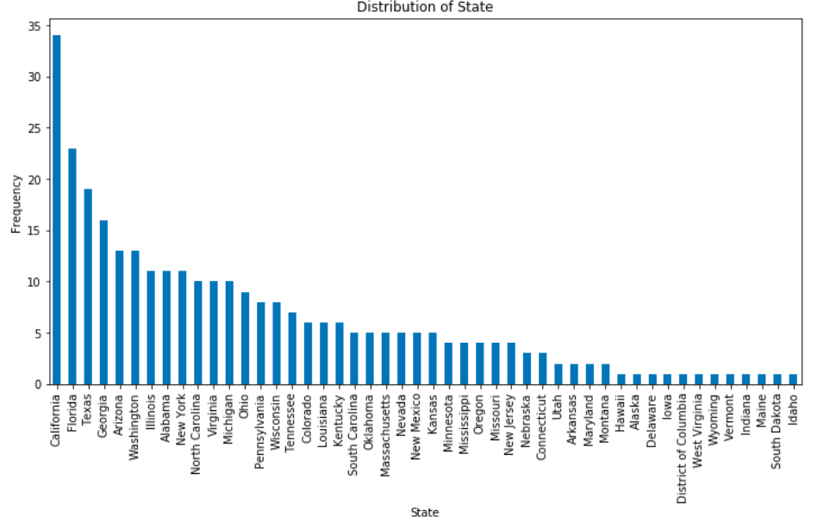
Conclusion
-California is the state where there is the more shooting.
-Connecticut is the state where there is the more victims fatalities

Slide 10
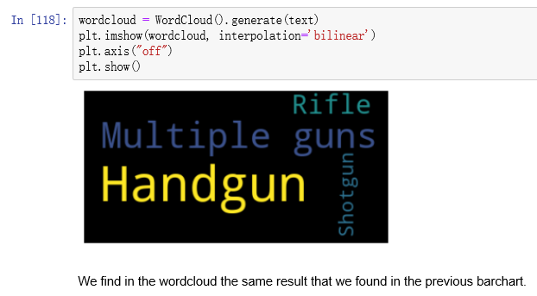
Conclusion
-Handgun is the type of gun that mostly to be used in shooting. We should keep a eye on person who by the handgun in case shooting happen.
-A new kind of chart that we didn't learn in class to do visualization in python.

Slide 11
Conclusion from API data:
Most Shooter age range in New York Most victims age range in New York | 18-24 25-44
Most dangerous district in NY Most locations district in NY | Brooklyn MULTI DWELL - PUBLIC HOUS
Shooter sex majority Victims sex majority | Male Male
Shooter's most race Victim's most race | Black Black
Most dangerous time during one day | 11:00pm-2:00am
Most shooting happened year during past 12 years | 2011

Slide 12
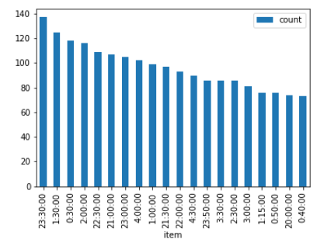
From 9:00pm to 2:00am most shooting happened. so try to go back home before 11:00pm everyday.
Conclusion:

Slide 13
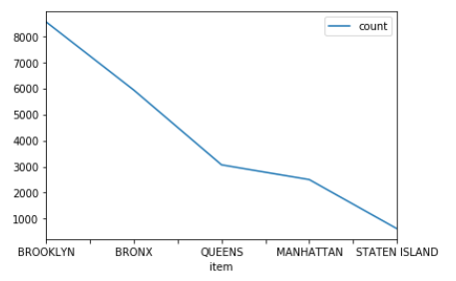
Brooklyn is the most dangerous district in New York for shooting happened most in this area, and Staten Island is the safest district in New York. It's better to rent a house in safer place for international students.
Conclusion:

Slide 14
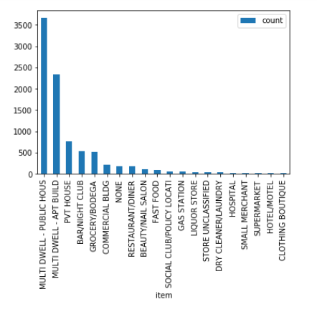
MULTI DWELL - PUBLIC HOUS has the most frenquency of shooting happening, which is most dangerous, students should avoid to go there, and CLOTHING BOUTIQUE is comparatively safe, which has the least shooting happened.
Conclusion:

Slide 15
Chanllenges that we meet in this project and what we can improve in future.
To improve the ability to search for the right data data source
Decision tree algorithm to learn and be used in future project.
Try to use the web scrubbing data resource in future projects.
To do more complicated statistical analysis.

